Slide 1


Serverless IoT for Data Processing
Team Members
Navanitha M
Sowmiya S
Srija R
Vihasini E
Sugeetha S
Varshini N
Notes:
‹#›

Slide 2


Abstract
This project centers on the revolutionary concept of serverless IoT data processing.
By eliminating traditional server infrastructure, we aim to boost efficiency, scalability, and cost-effectiveness in handling IoT-generated data.
Key objectives include developing a,
seamless data processing pipeline
enabling real-time analytics
ensuring scalability for dynamic workloads, and
prioritizing security measures.
Notes:
‹#›

Slide 3

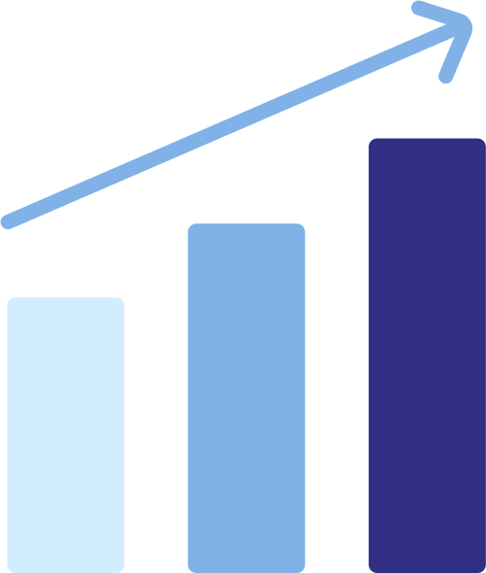




Problem Statement
Scalability
Over-complexity
Costs
Latency
Notes:
‹#›

Slide 4
Coding: Embedded Systems
Below is the pseudo code responsible for embedding the smart home devices and initializing basic commands to start analysing the environment.
// Pseudo-Code for IoT Device Embedded Programming
initializeHardware();
while (true) {
// Read data from sensors
sensorData = readSensors();
// Preprocess data
processedData = preprocessData(sensorData);
// Connect to the cloud
cloudConnection = establishCloudConnection();}
// Send data to the cloud
sendToCloud(cloudConnection, processedData);
// Sleep for a specified interval
sleep(INTERVAL);
Notes:
‹#›

Slide 5
Coding: Automotive Systems
Below is the pseudo code responsible for automation of the smart home devices and initializing basic commands to start automating the components in the environment.
// Pseudo-Code for Automation
initializeSystem();
while (true) {
// Check for incoming IoT data
incomingData = receiveDataFromIoTDevices();
// Trigger serverless data processing function
result = processIoTDataWithServerlessFunction(incomingData);
}
// Store or display results
storeOrDisplayResults(result);
// Set up notifications or alerts
if (result.isCritical) {
sendAlertNotification(result);
}
Notes:
‹#›

Slide 6


Solution
Serverless Architecture
Automatic Scalability.
Cost-Efficiency
Real-Time Processing
Streamlined Operations
Security Measures
User-Friendly Interfaces
Notes:
‹#›

Slide 7




Design Thinking Based Innovative Solution
Function-as-a-Service (FaaS) Integration
Edge Computing Integration
AI-driven Optimization
Multi-Cloud Compatibility
Notes:
‹#›

Slide 8
Benefits
Scalability 🚀
Cost Savings 💰
Serverless architecture allows for effortless scaling to handle any IoT data processing demands.
Optimize resource allocation and pay only for the processing power you need, reducing overall costs.
Real-Time Insights 📊
Flexibility & Agility 🌐
Leverage serverless IoT to gain real-time insights from data, enabling rapid decision-making and improved operational efficiency.
Quickly adapt to changing requirements and seamlessly integrate with other systems for enhanced flexibility.
Notes:
‹#›

Slide 9

Limitations
1
Vendor Lock-In 🔐
2
Debugging Challenges 🐞
Reliance on a specific cloud provider may limit portability, requiring careful consideration of long-term implications.
Identifying and resolving issues in complex serverless IoT setups can be more challenging compared to traditional architectures.
3
Data Security Concerns 🔒
Data privacy, encryption, and compliance should be carefully addressed when using serverless IoT for sensitive information.
Notes:
‹#›

